Slide 1
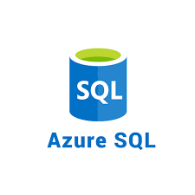



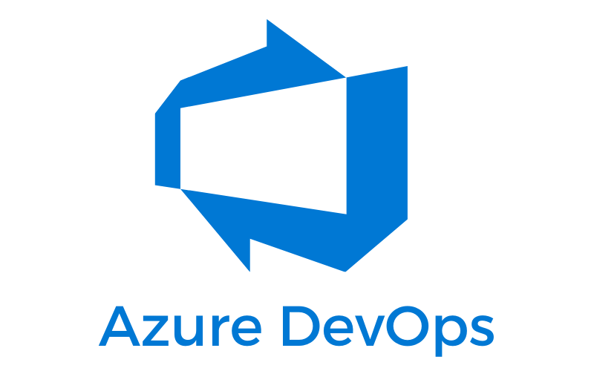

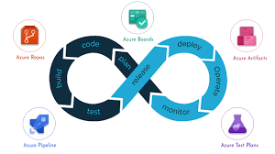
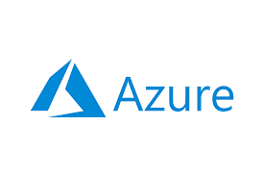
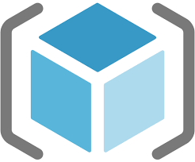
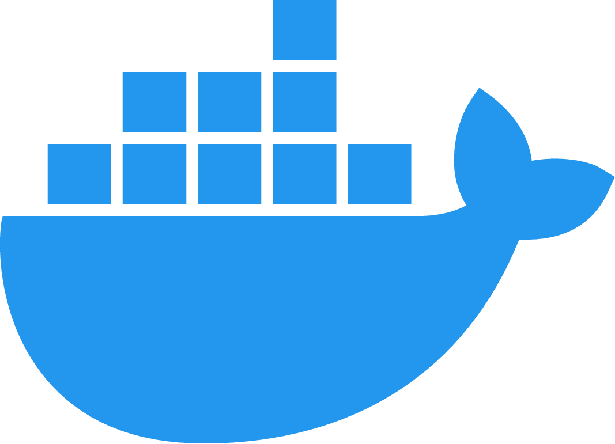


Slide 2
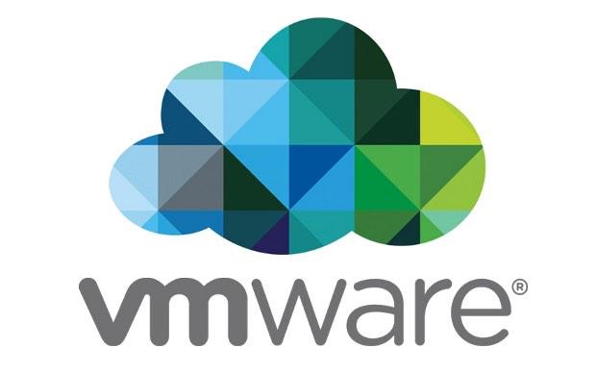
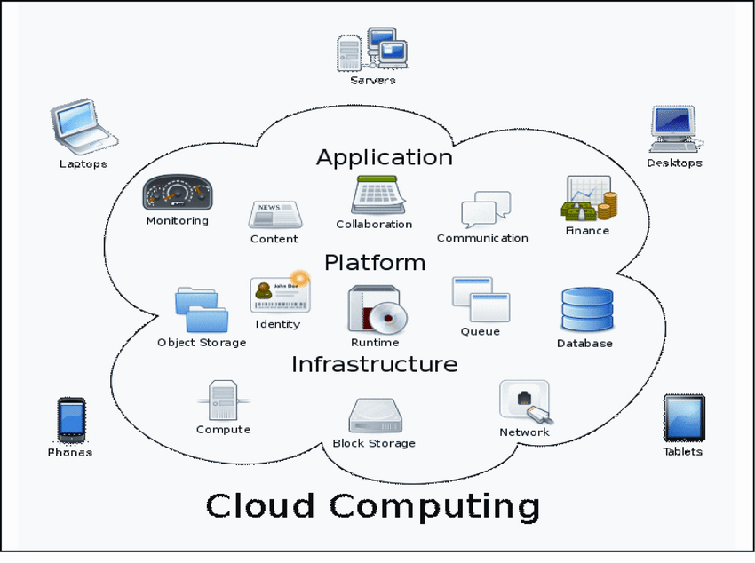
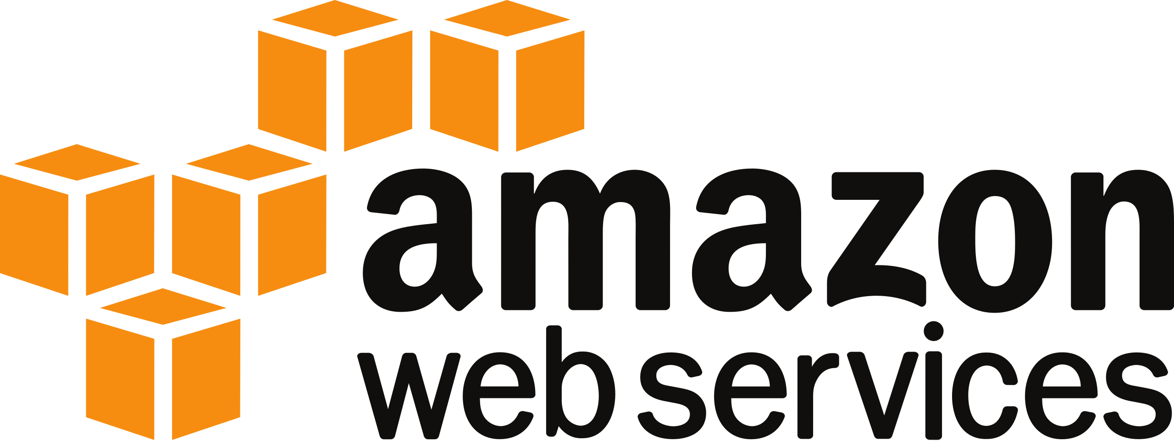
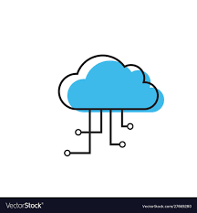
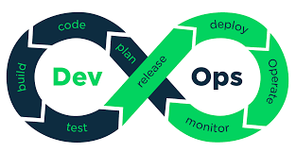
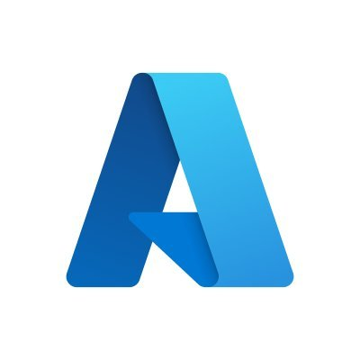


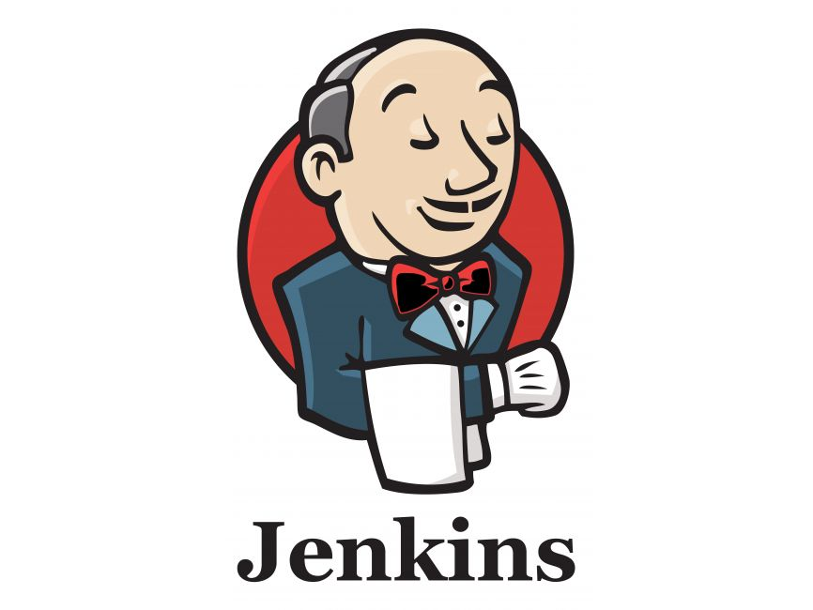
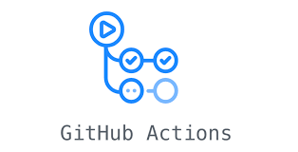
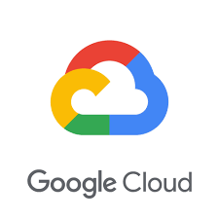
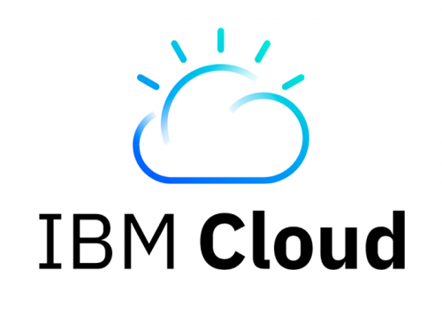


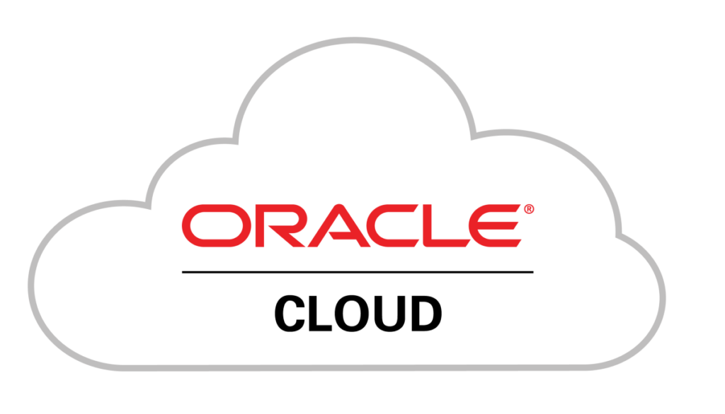

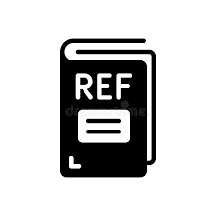
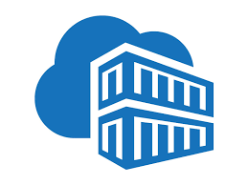
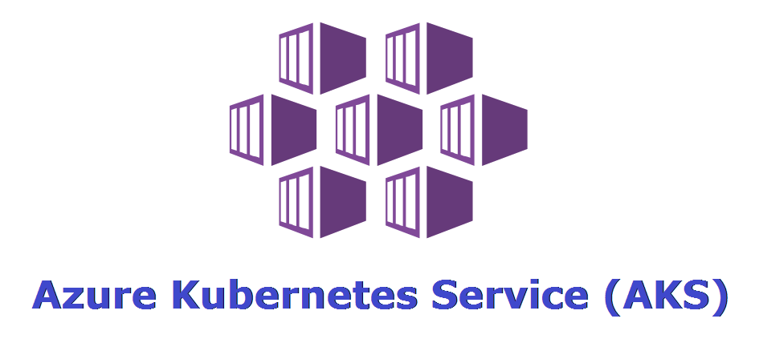
What you will learn..!?
Cloud Computing Concepts
DevOps Concepts
Azure Cloud Services
Azure DevOps Services
Azure DevOps CI & CD Pipelines
Automation Scripting
References
Duration: 45-60 days
Daily 1-1.5 hrs .. Weekdays

Slide 3
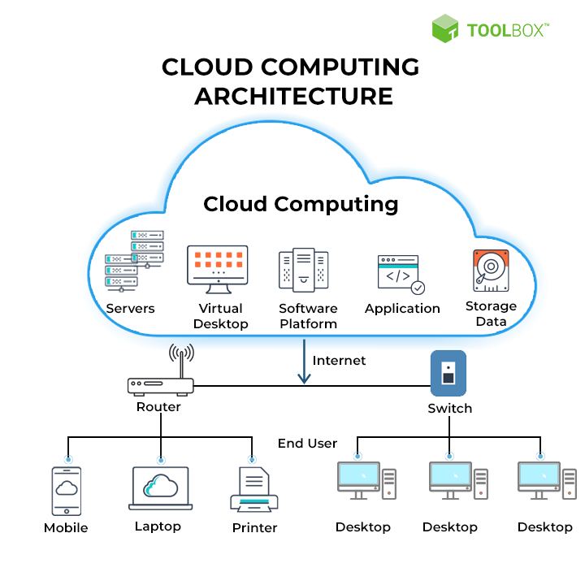
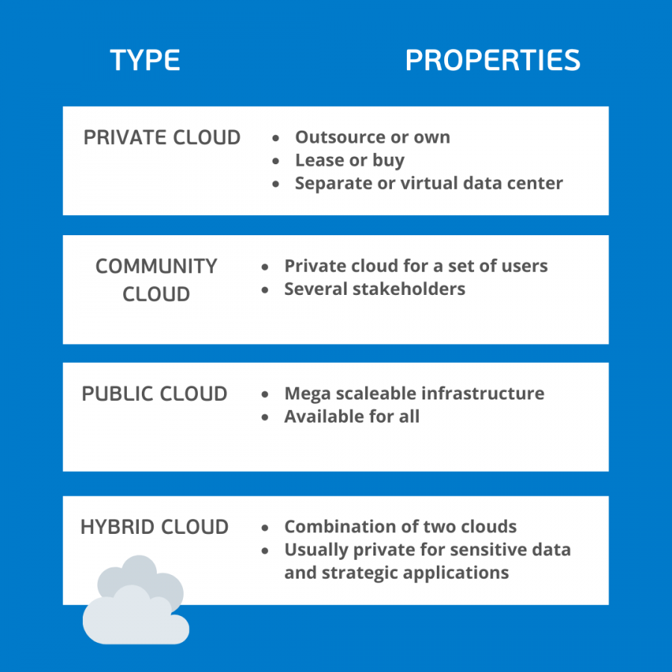
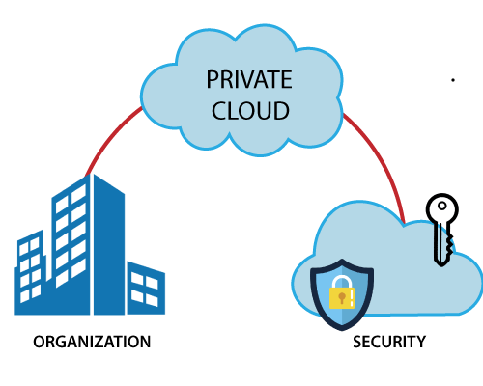

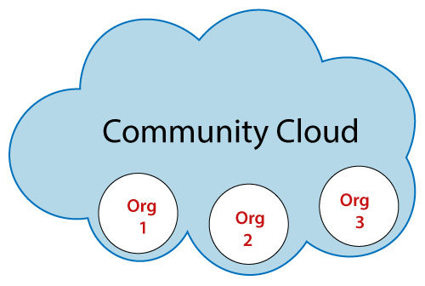
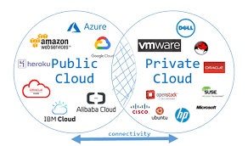
Cloud Computing Concepts
Cloud Deployment Models
------------------------------------
Powered by

Slide 4
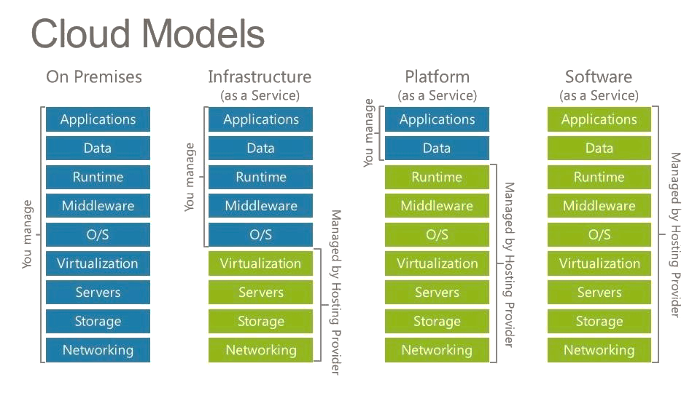
Cloud Computing Concepts

Slide 5
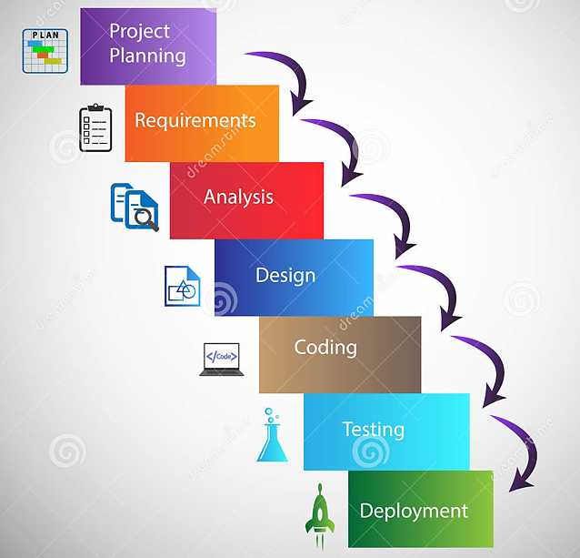
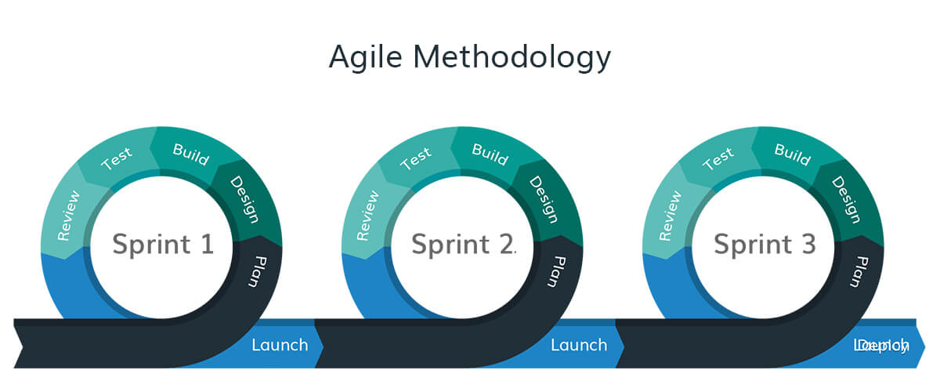
DevOps Concepts
“DevOps is the union of people, process, and Technology to enable continuous delivery of value to
Customers”
Software Development Lifecycle(SDLC)
Waterfall Model
Each sprint duration – 2 to 6 weeks

Slide 6

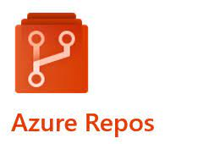

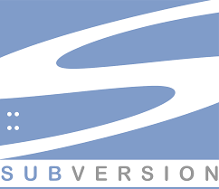



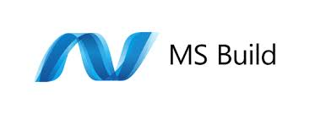




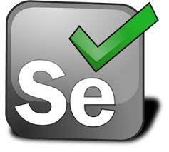
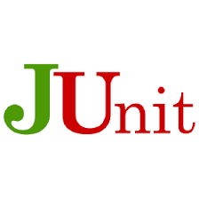
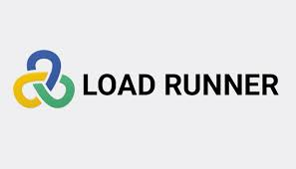

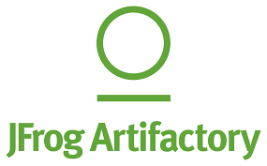

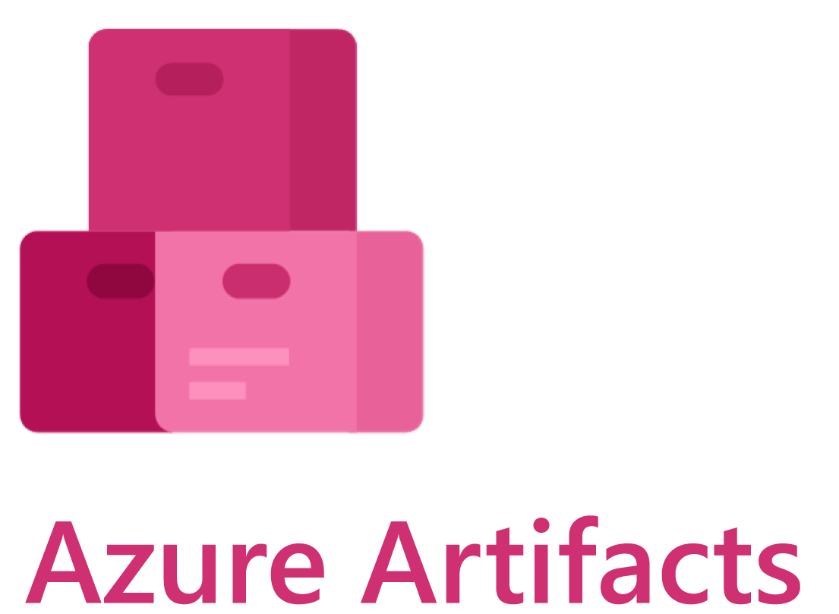
DevOps Concepts
Tools in DevOps(Development + Operations)
Development:
Code Repository –
Build –
Code Analysis –
Test --
Artifactory --

Slide 7

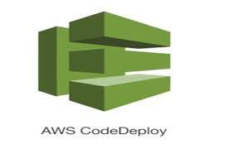

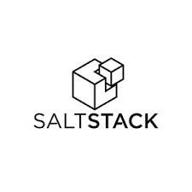


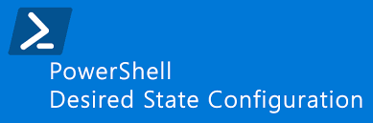

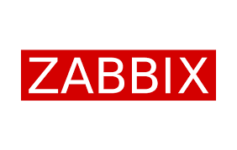
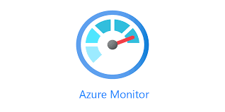

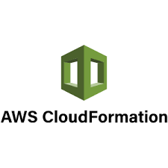


DevOps Concepts
Tool chain in DevOps(Development + Operations)
Operations:
Deploy tools --
Configuration Management --
Monitor --
Infrastructure as Code –
Scripting --

Slide 8




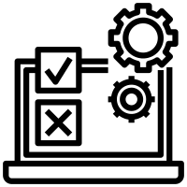

DevOps Concepts
Continuous Integration and Deployment(CI&CD)
Continuous Integration:
Push packages/binaries
to storage
Code check-in
Build/Compile
Unit Test
Code Repo
Build Tools
Test Plans
Artifactory
Developers
Continuous Deployment:
Automation Scripts
Functional Test
Final Test
Dev Environment
Test Environment
Prod Environment
Ops/Infra.Build Team

Slide 9
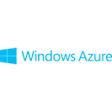
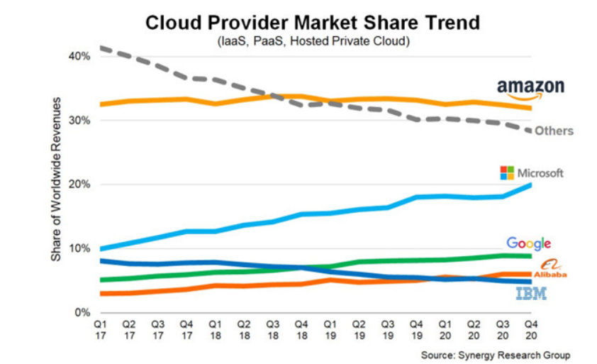
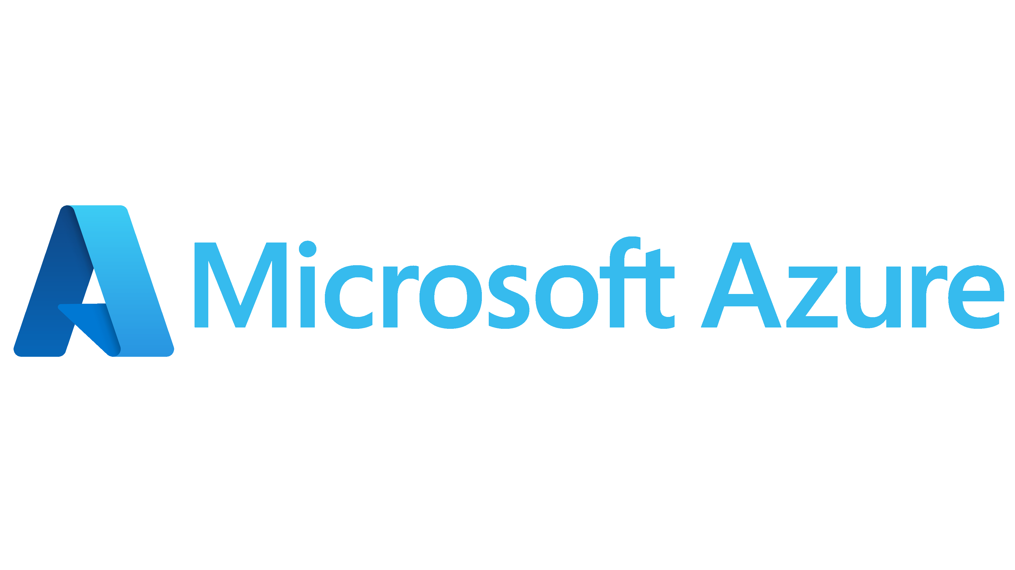
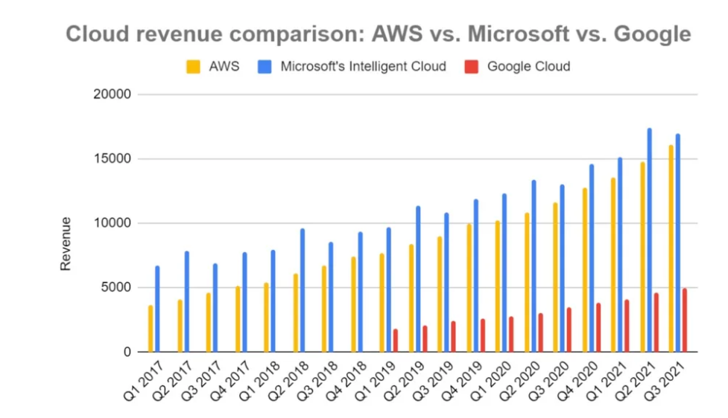
Azure Cloud Services
Why Microsoft Azure?
Launched in 2010 as
Renamed in 2014 as
URL For azure cloud -- https://portal.azure.com
Azure Regions - https://azure.microsoft.com/en-us/global-infrastructure/geographies/#geographies

Slide 10
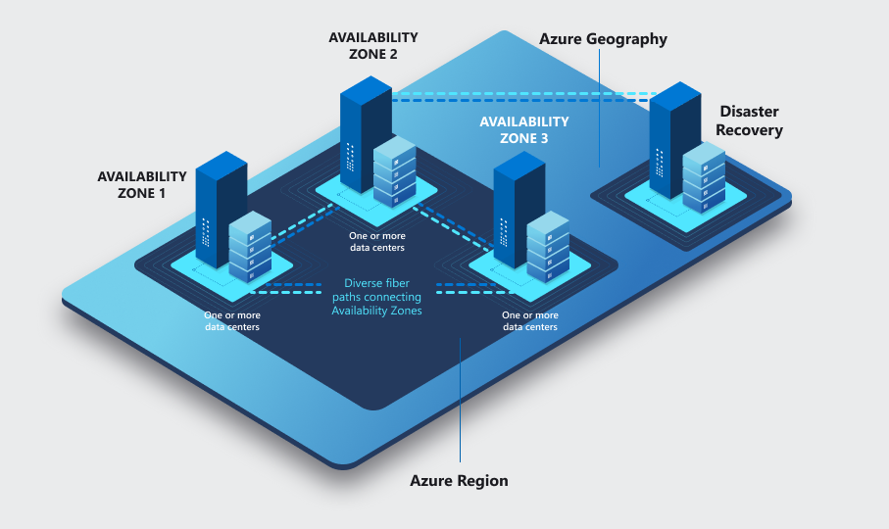

Azure Cloud Services
Azure cloud Key terms
Subscription- an agreement between organization and Microsoft to use resources.
Resource Groups- a logical container that holds related resources for an Azure solution
Regions- a set of datacentres deployed within an interval-defined perimeter and
connected through a dedicated regional low-latency network
Availability Zones- connected by a high-performance network
with a round-trip latency of less than 2ms
Azure Resource Manager- is the deployment and management service for Azure.
It provides a management layer that enables you to create, update, and delete resources in your Azure account
Azure CLI- a cross-platform command-line tool to connect to Azure and execute administrative commands on Azure resources
Cloud Shell- is an interactive, authenticated, browser-accessible shell for managing Azure resources
Tags- to your Azure resources, resource groups, and subscriptions to logically organize them by values that make sense for your organization

Slide 11



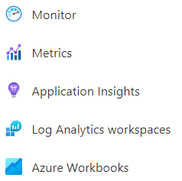
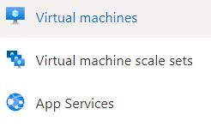
















Azure Cloud Services
List Of Services

Slide 12



Azure DevOps Services
Azure DevOps Architecture:
Azure DevOps Services:
URL: https://dev.azure.com

Slide 13
Automation Scripting
PowerShell and Bash:
Azure CLI :
Variable declarations
Data Types
Loops and iterations
Usecases
Installation
Configuration
Most useful commands overview

Slide 14
Any Questions?
Course Duration: ~ 45 days
Mon – Fri
1 – 1.5 Hrs.

Slide 15
Thank you…!!!

